Slide 1

Linear Algebra
Evolve Machine Learners
Notes:
https://techxplore.com/news/2018-02-google-ai-heart-disease-pictures.html

Slide 2
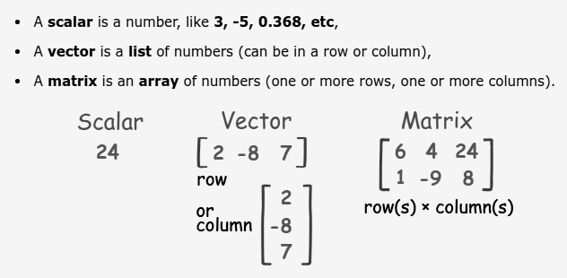

Slide 3
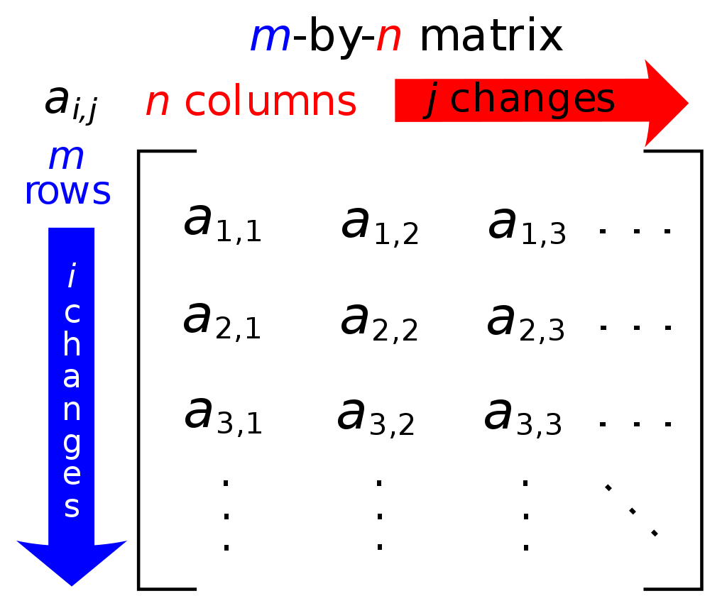
Vectors - 1 Dimensional
Matrices - 2 Dimensional
Tensors ??

Slide 4
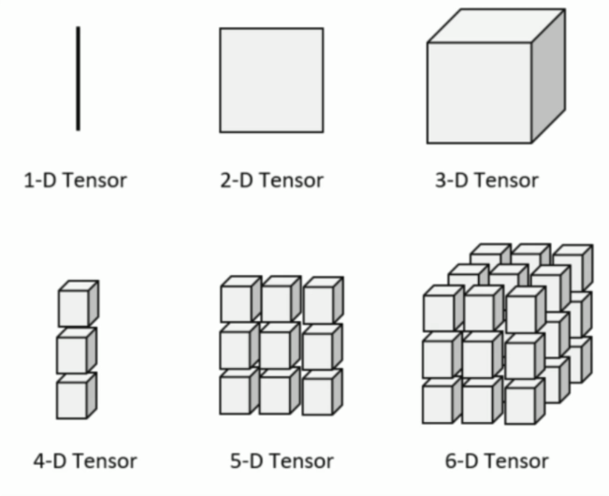

Slide 5

Matrix Operations

Slide 6
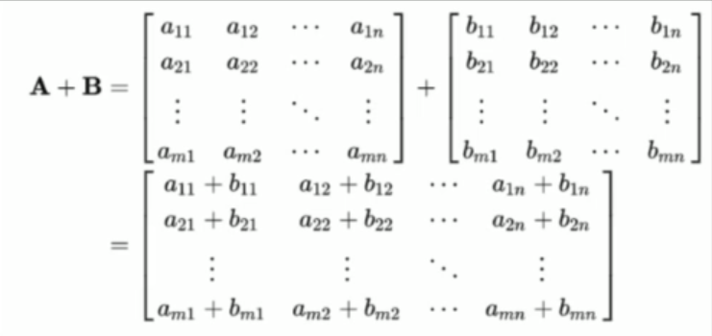

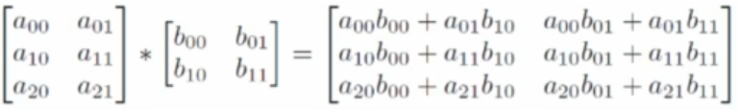
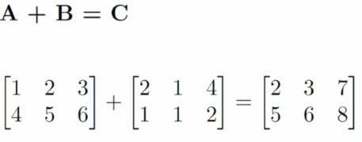
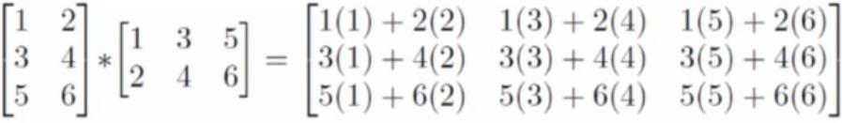
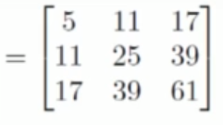
Addition
Multiplication
3 rows * 2 columns = 3 rows, 2 columns

Slide 7
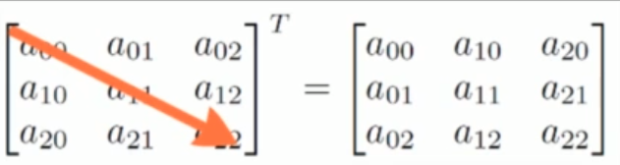
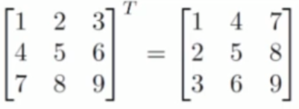
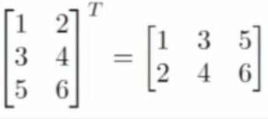
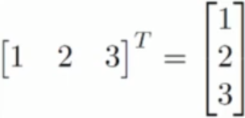
Transpose

Slide 8

Vector and Matrix Norms

Slide 9
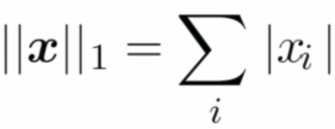
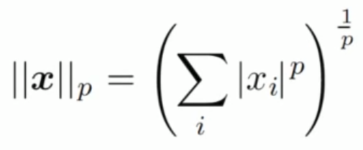

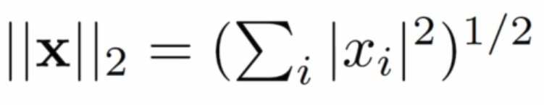
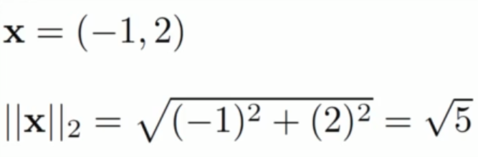
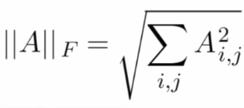
Norms (The Lp norm)
The L1 norm
The magnitude of a vector
The Max norm
Euclidean Norm (The L2 norm)
The Frobenius norm

Slide 10
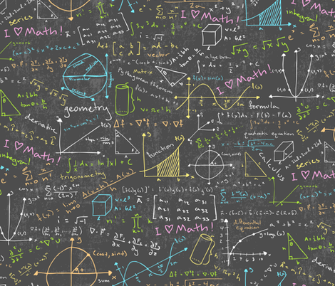
Multivariate Calculus

Slide 11
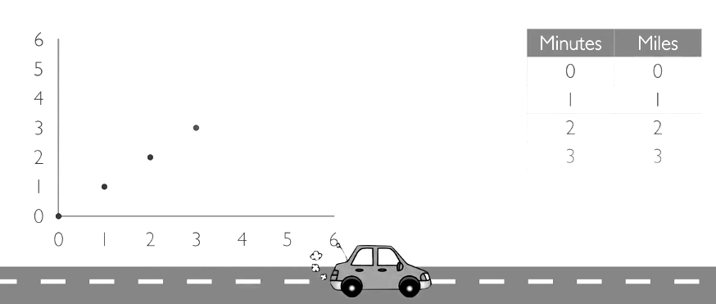
Derivative (d/dx)
Position = x(t)
Speed = dx/dt

Slide 12
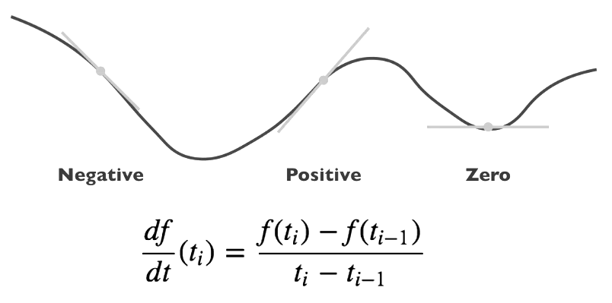

Slide 13






Scalar Derivative Rules
Constant
Example:
Power Rule
Example:
Multiplication
Example:

Slide 14

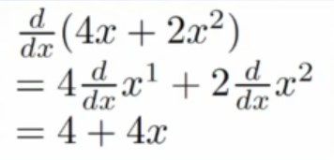

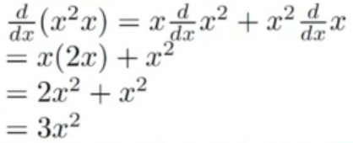
Scalar Derivative Rules
The Sum Rule
The Product Rule

Slide 15

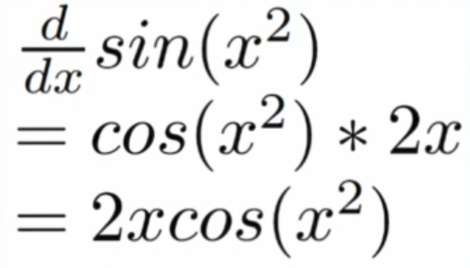
Scalar Derivative Rules
The Chain Rule

Slide 16

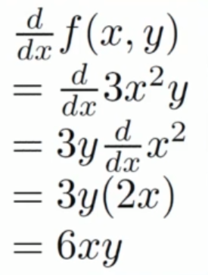
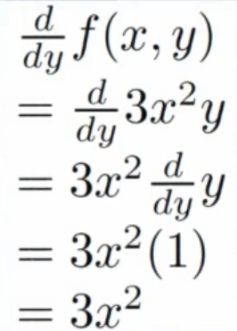
Partial Derivates

Slide 17
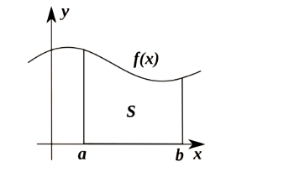
Integration
Integration is the reverse differentiation or often called the anti-derivative

Slide 18



Type of Integral
Indefinite
Definite
The Anti-derivative

Slide 19




Rules of Integration
The Power Rule
Constants

Slide 20



Evaluating Definite Integrals

Slide 21
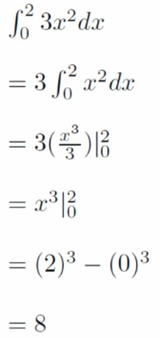

Examples

Slide 22


Gradient
Partial derivatives can be organized into a vector

Slide 23


The gradient of f(x,y)
Examples in two dimensions:

Slide 24

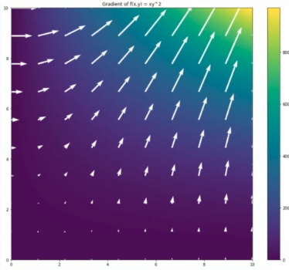
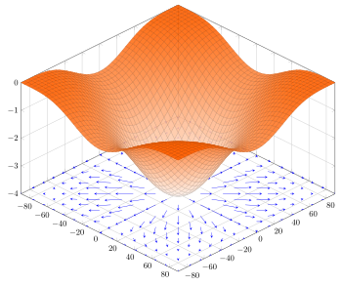
f(x,y) = xy^2

Slide 25

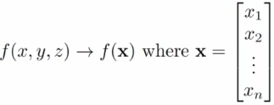

The Jacobian Matrix
Examples

